Slide 1


Certification CDSD Block 1 & 3
August 28th, 2025 – Louis Le Pogam

Slide 2
Agenda
Block 1 - Build & Manage a Data Infrastructure – Kayak Project
Block 3 – Unsupervised Machine Learning – Uber Pickups Project

Slide 3

Project Reminder
Project
Kayak Marketing Team would like to create a holiday recommendation application based on :
Weather
Hotels in the area
Based on real-time data
Goal
The data are not available and the goal is to get the needed data as following:
Scrape data from destinations.
Get weather data from each destination.
Get hotels' info about each destination.
Store all the information above in a data lake.
Extract, transform and load cleaned data from your datalake to a data warehouse.

Slide 4
4 building blocks for the data scrapping model
Description
1
Geolocalisation
Processing of list of cities by obtaining GPS coordinates and INSEE codes with API
Saving all data to CSV for weather queries
2
Weather Data
Retrieving 7-day weather forecasts for cities based on INSEE codes
Ranking cities based on customizable criteria and creates aggregated rankings
Saving ranked list based on number of favorable days to CSV
3
Booking Website Scrapping
Taking the top 5 cities based on previous analysis
Searching for hotels in each city available on booking.com
Saving in into a JSON file
4
Transformation and Storage
Processing previous data by removing low-quality hotels and identifying consecutive night availability
Creating interactive visualizations and uploads all results to AWS S3 and SQL server

Slide 5
All 4 blocks are used to get the final output
Geolocalisation
get_coordinates
Transformation and Storage
get_weather_data
get_city_ranking
Weather Data
Scrapy crawl
Open saved JSON
get_weather_data
get_city_ranking
Output stored on S3 and SQL server - Weather and hotel data - Visualization of available hotel for top cities
Booking Website Scrapping

Slide 6
The weather module scraps the weather by city and ranks them based on defined ideal conditions
get_weather_data
get_city_ranking
Reads a list of French cities from a file based on the INSEE code
Connects to a weather service (Meteo Concept API) for each city
Gathers 7-day forecasts including: - Daily rainfall predictions - Temperature highs and lows - Wind speed information
Organizes everything in a DataFrame where each row represents one day's weather forecast for a specific city
Flags Less-Than-Ideal Weather Days when: - Too hot / Too cold / Too rainy / Too windy - Default value: 35°C / 20°C/ 10mm / 50 km/h - Can be changed depending on the season
Calculates Problem Days for each city over the forecast period
Ranks Cities by: - Fewest problematic weather days - Lowest average rainfall as tiebreaker
Output : DataFrame with weather prediction for eachs targeted cities
Output : DataFrame with a prioritized list of cities with optimal weather conditions for travelers

Slide 7
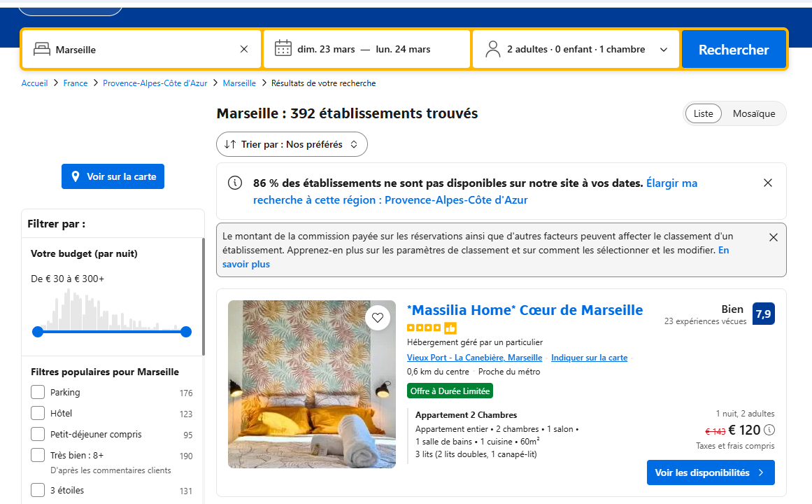
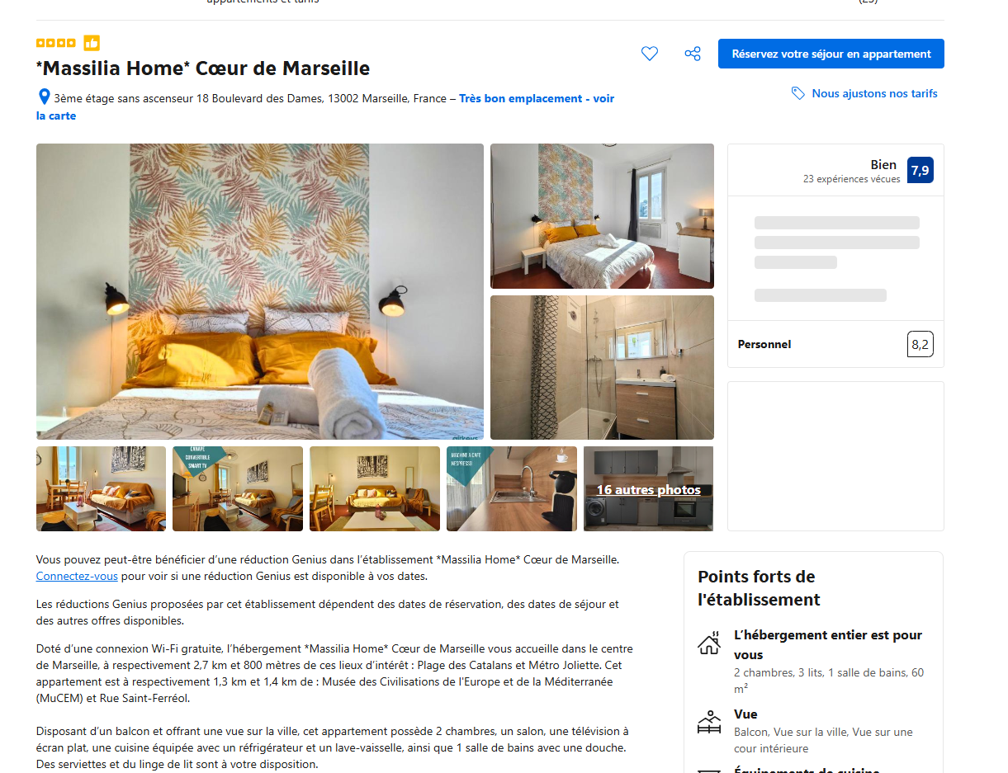
700 pages scrapped to get the available hotels of the next 7 days
Get Weather Data
Open file of ranked cities and select top 5
Get URL for each city and date
Loop on each cities and for the next 7 days
Get the URL of the search for each city x date
Get the Details from the Search Results
For each results on the search page, get the main info : Name, ranking, price, distance…
Keep only 20 first results to limit output size
Open each page and get detailed data
For each hotel, open the hotel page to get detailed info : Adress, latitude, longitude, description, URL…
Store Data in a JSON file
Gather all data in one JSON
700 pages scrapped (5 cities x 20 hotels x dates x 7 dates) in 6 minutes

Slide 8
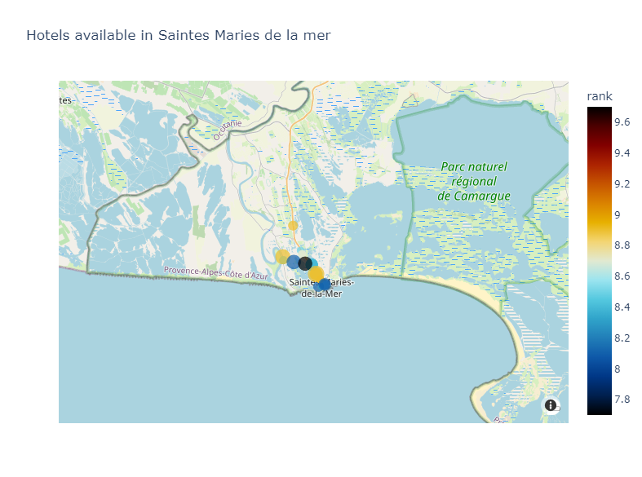
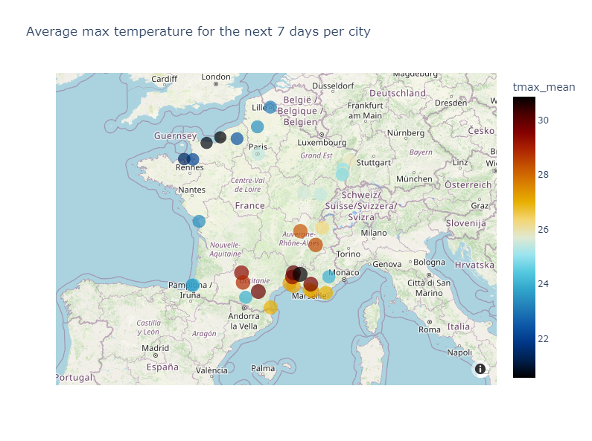
All outputs are stored on a AWS S3 and SQL server and ready to be used
Output 1 : All database
Output 2 : Visualization of available hotels for each top 5 cities
Output 3 : Overview of average temperature for the next 7 days of all targeted cities
Dataframe with weather forecast
Dataframe with City Ranking
JSON with all booking.com data scrapped
All outputs are stored in a S3 and SQL server and ready to be extracted and used

Slide 9
Q&A

Slide 10
Agenda
Block 1 - Build & Manage a Data Infrastructure – Kayak Project
Block 3 – Unsupervised Machine Learning – Uber Pickups Project

Slide 11

Project Reminder
Project
One of the main pain point that Uber's team found is that sometimes drivers are not around when users need them.
Therefore, Uber's data team would like to work on a project where their app would recommend hot-zones in major cities to be in at any given time of day.
Goal
The target of the project is to
Develop an algorithm to identify "hot zones" where drivers should position themselves
Create time-based recommendations that adapt to changing demand patterns
Visualize results for easy implementation by drivers

Slide 12
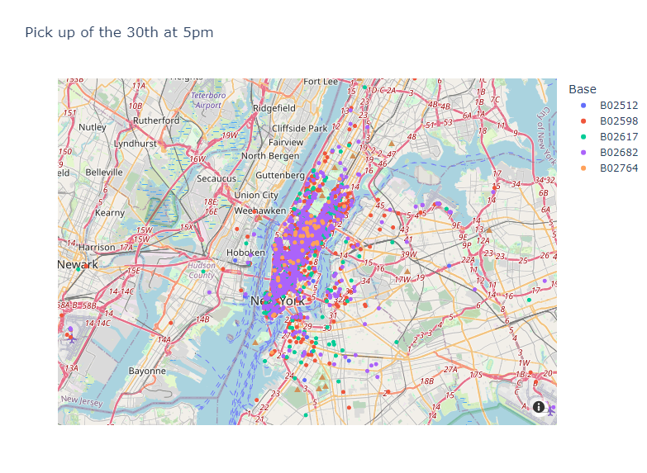
The dataset represents latitude and longitude of 564k pickups in April 2014
Dataset description
Overview of the pickup location for a given hour oof a given day
Dataset of April 2014 used with 564k lines
4 columns: - Date - Latitude - Longitude - Base : Internal code, not used in the analysis
Preprocessing limited to converting the date column into several sub-columns
Focus on New York City inside this latitude and longitude line : - Latitude minimum = 40.4774 - Latitude maximum = 40.9176 - Longitude minimum = -74.2591 - Longitude maximum = -73.7004
Analysis done on the 30th of April 2014 at 5pm to limit the number of lines

Slide 13
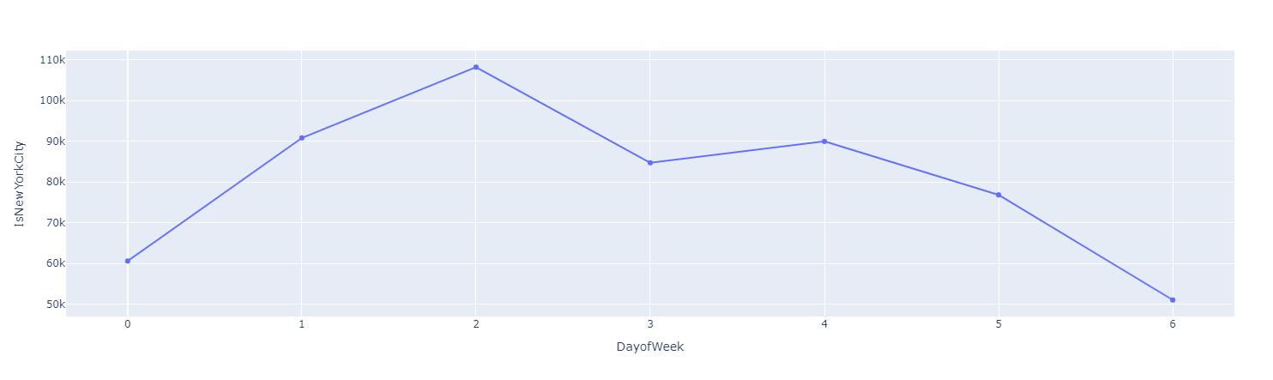
Monday and Sunday are the lowest day while the peak in on Wednesday
Number of pickups per Day | April 2014, NYC only, 0 = Monday
Monday
Tuesday
Wednesday
Thursday
Friday
Saturday
Sunday

Slide 14
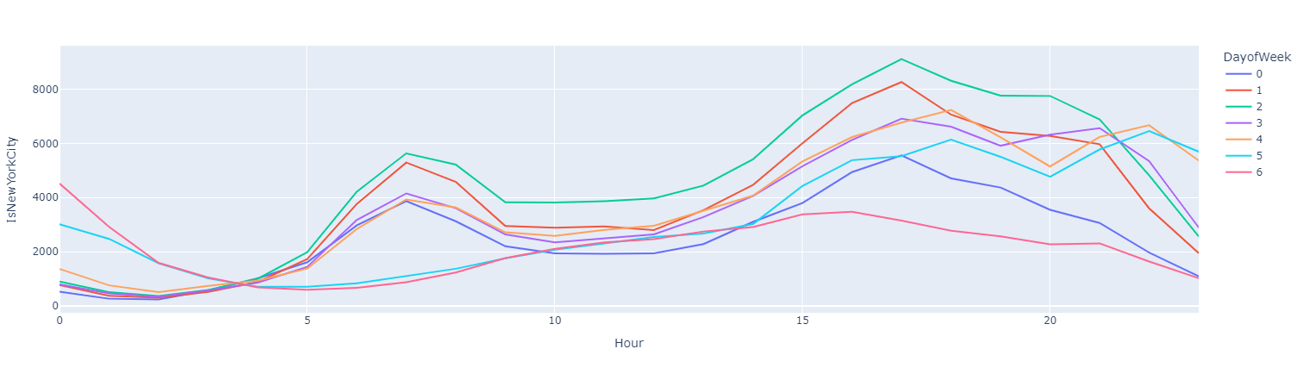
During the week, there is a peak at 7am then between 5pm and 8pm while the night is busy during the weekend
Number of pickups per Hour depending on the day | April 2014, NYC only, 0 = Monday

Slide 15
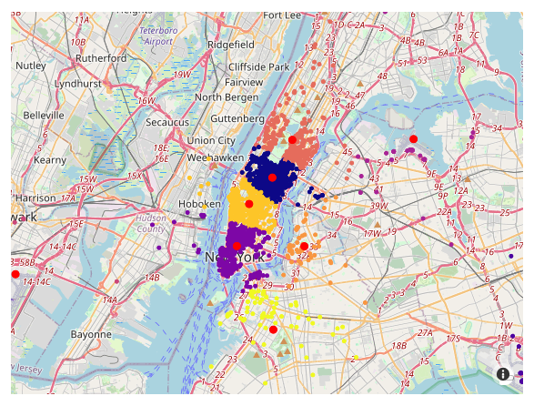
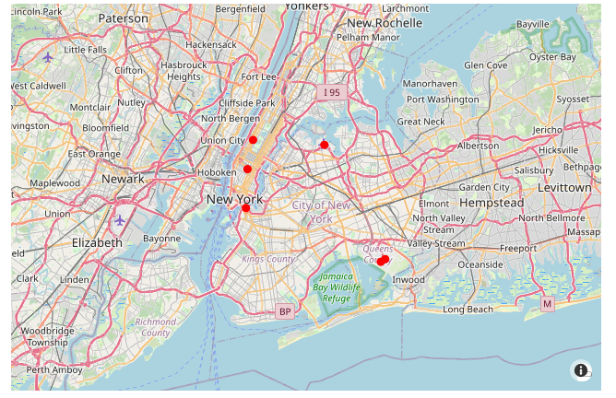
DBScan is used to calculate coordinates of hot zones at any given time
Kmeans Clustering
DBScan
Description
Elbow and silhouette methods to get the optimal number of clusters
9 clusters seems to be the best for April 30th
Description
DBScan used to handle different numbers of cluster depending on the time
Parameters : Epsilon = 0.1 / Min Sample = 10
6 clusters + outliers
Cluster Overview
Cluster Center Overview
DBScan chosen for algorithm as the number of cluster adapts to the dataset

Slide 16
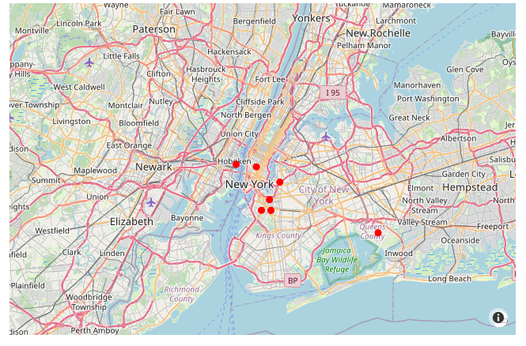
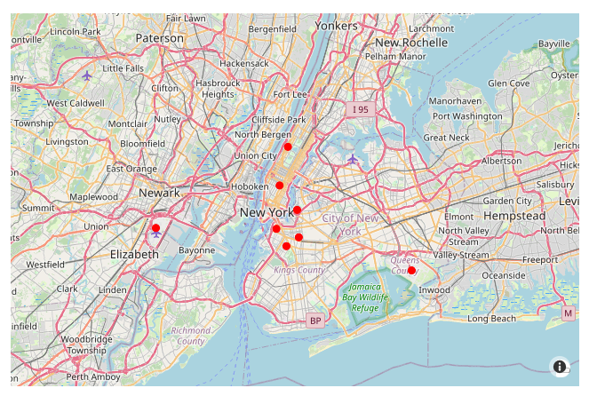
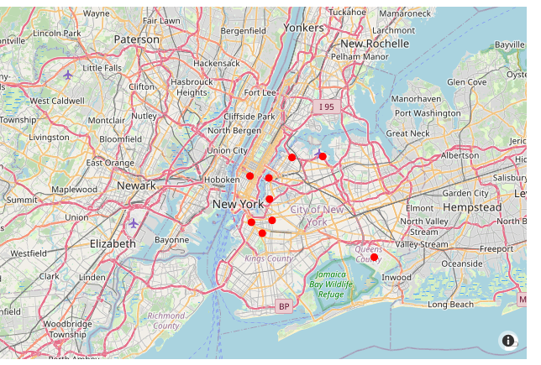
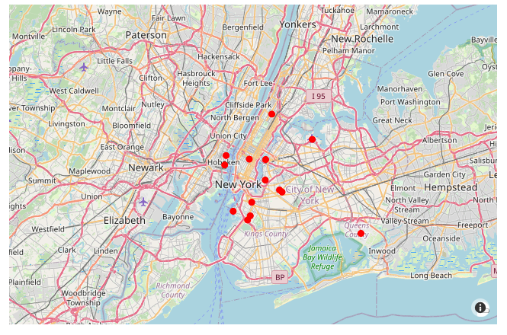
Hot zone are calculated and plotted for any given time with a DBScan clustering
Plot_hot_zone function
Evolution of hot zones for a Saturday at 12am, 6am, 12pm, 6pm
12am
6am
Input : dataset, day of the week, hour, dbscan parameters
For any given hours, would calculate the clusters center and plot them
The output would be a map with the hot zones of this hour
For a given day, the evolution of hot spots can be shown by looping over different hours
12pm
6pm

Slide 17
Q&A

Slide 18

Thanks!

